Slide 1
ANC3 PAC MAN!!! 3nd Iteration Hugo Barbachano & Tidiane Toure

Slide 2
Analysis

Slide 3
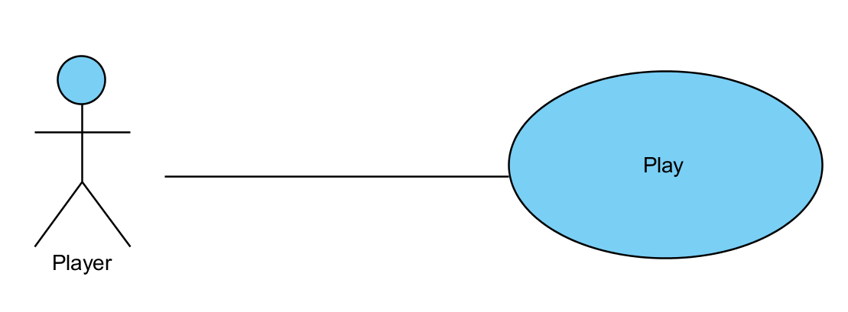
Use Case Diagram

Slide 4
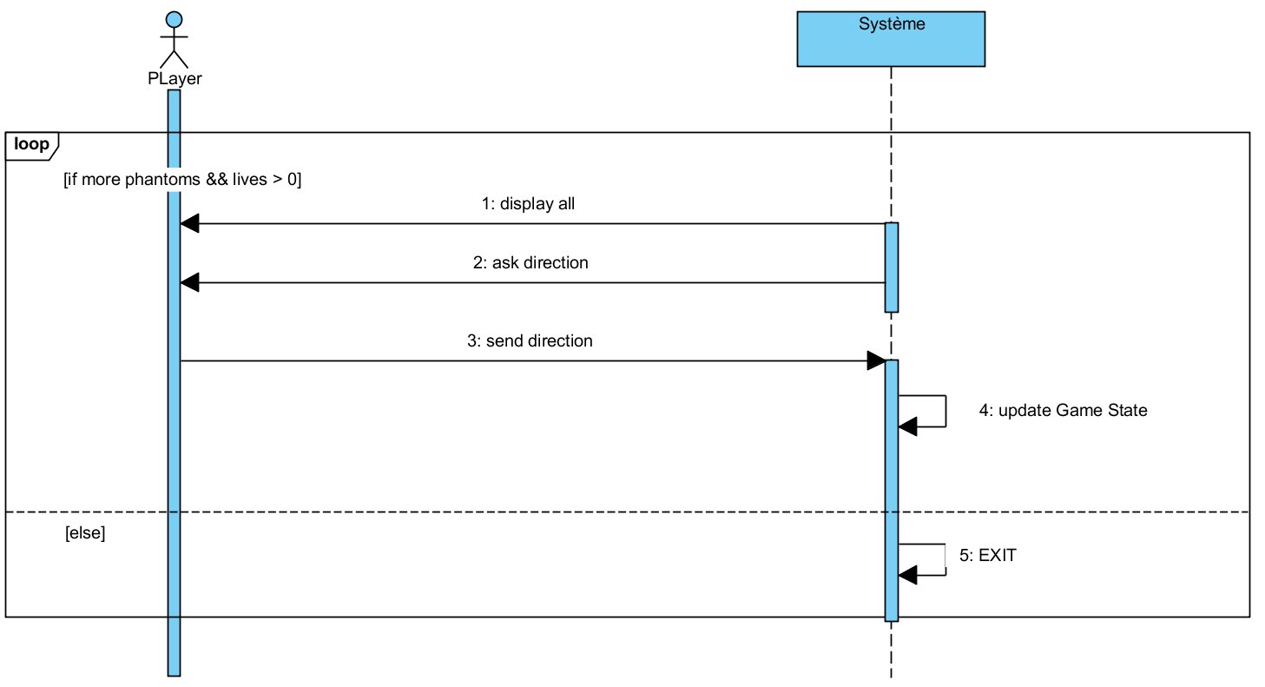
DSS Play

Slide 5
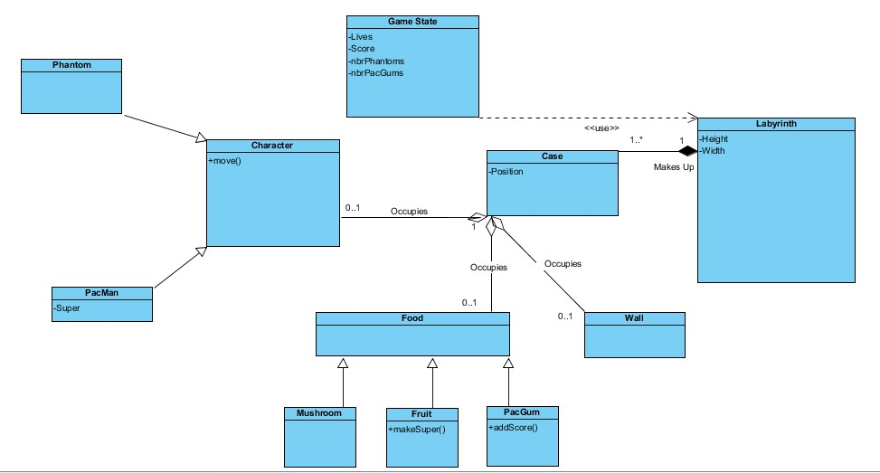
Domain Classes

Slide 6
Conception

Slide 7
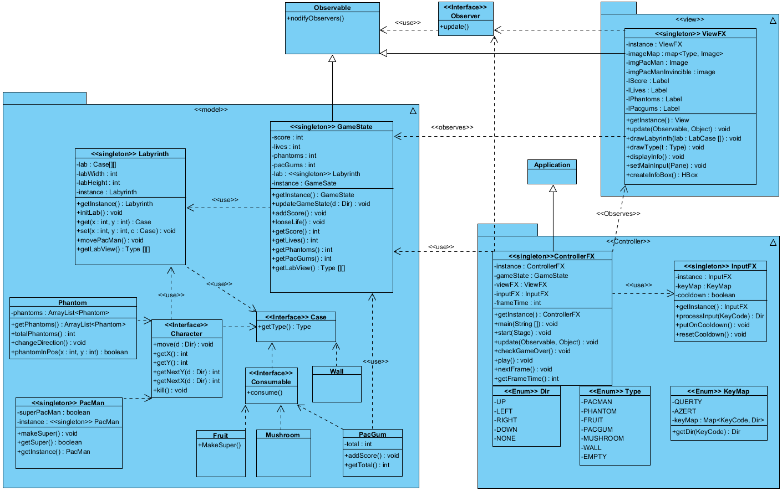
Software Classes (with JavaFX)

Slide 8
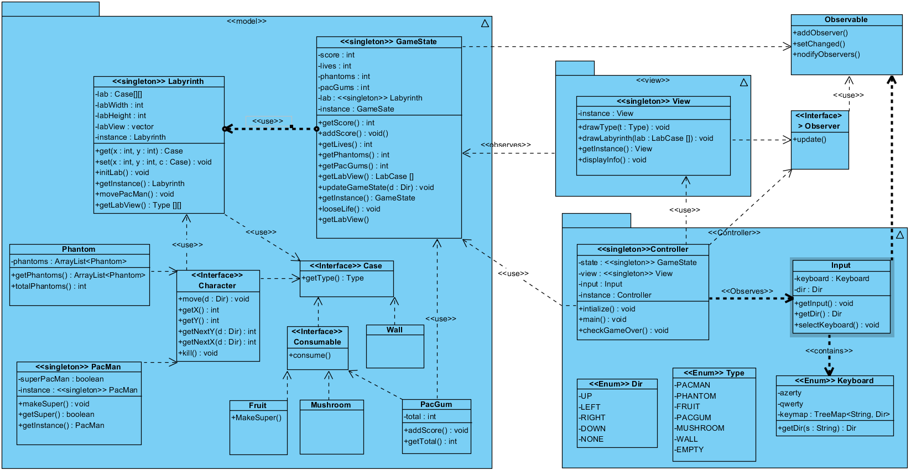
Software Classes (with console)

Slide 9
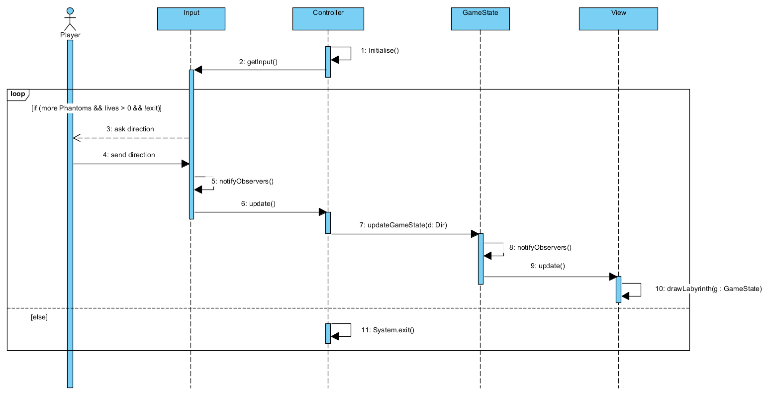
DS Play

Slide 10
Readme
Main Game Loop
In its main() the Controller creates all the objects, sets itself as an observer of ViewFX and sets ViewFX as an observer of GameState.
Then the Controller calls play() which runs an infinite Timeline that regularly calls nextFrame():
– At any time ViewFX gathers the key press and notifies ControllerFX.
{
1 - In nextFrame() ControllerFX processes the input with InpuFX.proccessInput(KeyCode) and calls GameState.updateGameState(Dir).
2 - In updateGameState() GameState handles the movement and notifies the ViewFX.
3 - ViewFX gets a Type[][] copy of the labyrinth as a parameter in its update() and draws the game it based on that.
4 - TheController calls Platform.exit() if the conditions for Game Over or Win are met or if the player types “x”.
}

